Slide 1

CSC 47700
ML Project Presenation
Alhamza Muswara

Slide 2

LSTM MODEL
An LSTM (Long Short-Term Memory) model is a type of recurrent neural network (RNN) designed to handle sequences of data and learn long-term dependencies. So, involving time series data or any sequence where the order and context of the data matter, in our case stock prices are difficult to predict with feature data such as open, high, and low values for a stock on a previous day alone.
Notes:
fddsf

Slide 3
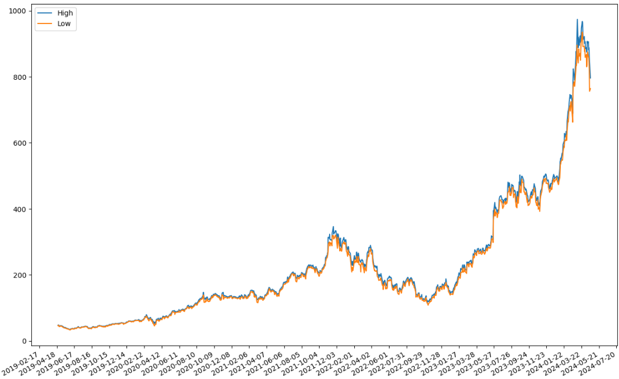

Slide 4
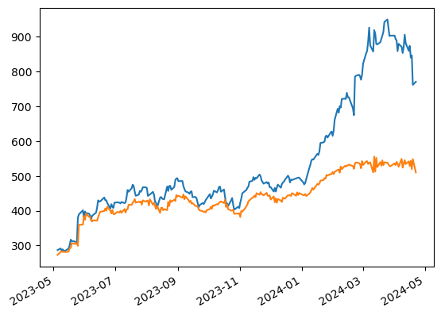
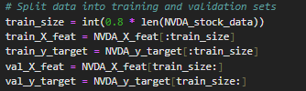
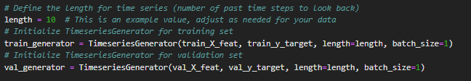
This model doesn’t seem to fit actual prices, but we do see a pattern produced by our model that is like the actual price trend.

Slide 5
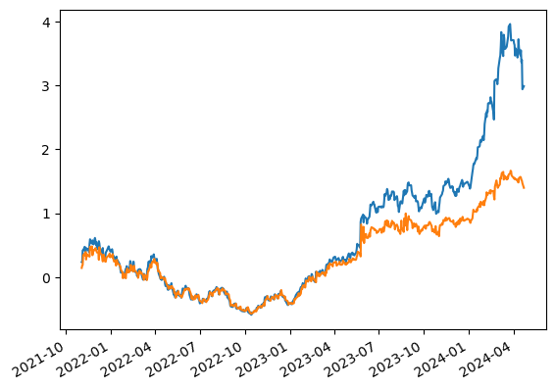
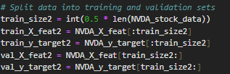
Using only half of the training data has given me better results although there are still issues from around 2023-05 onwards. Which leads me to think that overfitting could be the issue which can explain issue around significant changes.

Slide 6
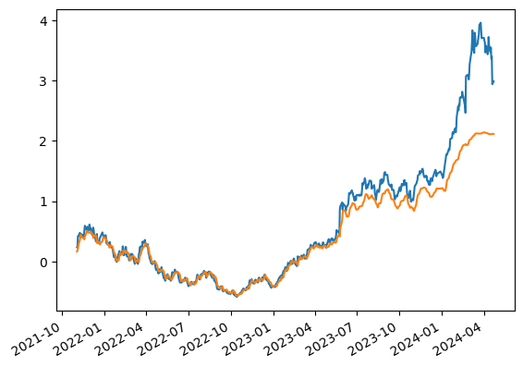
The same model but training only using 10 epochs.

Slide 7
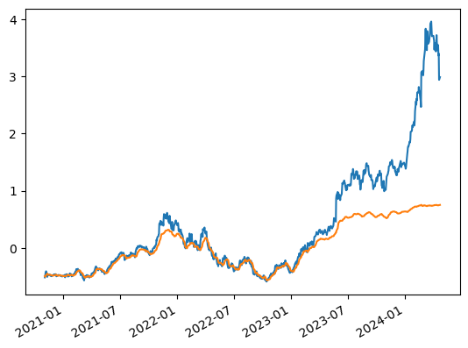
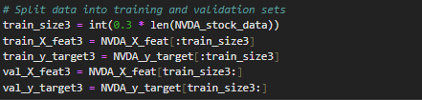
Here my third model is only trained on 30 percent still showing inaccurate predictions from 2023 – 05.

Slide 8
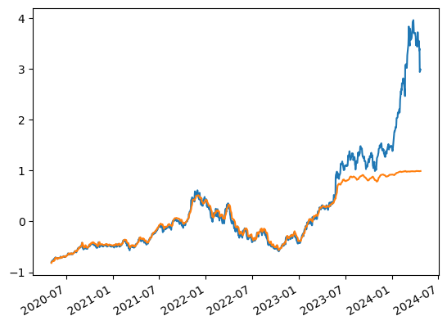
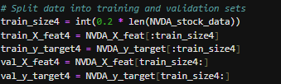
These results lead me to simply train handful of sample near current times. The first 80% percent is not good enough to be a representative of recent data.

Slide 9
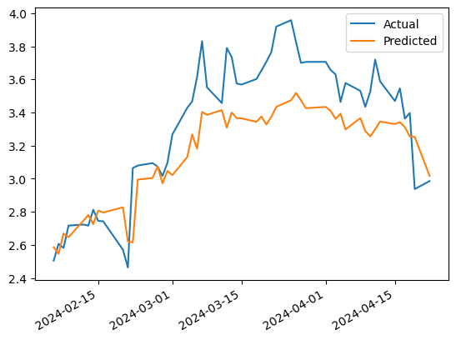
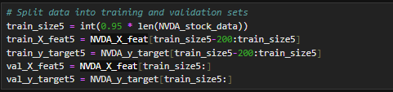
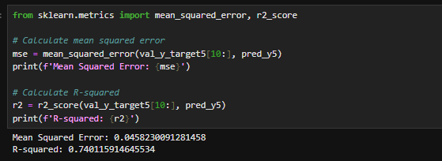
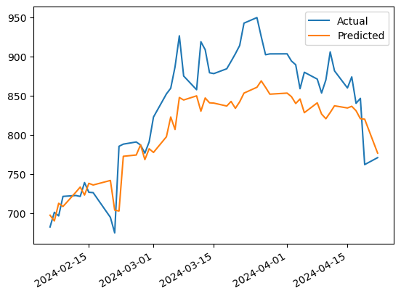
We see better results, but not enough to be beneficial.
Notes:
Mean Squared Error (MSE): The MSE of your model is now 0.0458230091281458, which is a substantial decrease from the previous value. This suggests that your model’s predictions are now closer to the actual values, and the model is doing a better job at fitting the data.
R-squared: The R-squared of your model is now 0.740115914645534, a significant increase from the previous negative value. This value indicates that approximately 74% of the variability in the dependent variable can be explained by the independent variables in your model. This is a good indication that your model is now capturing the underlying pattern in your data quite well.

Slide 10
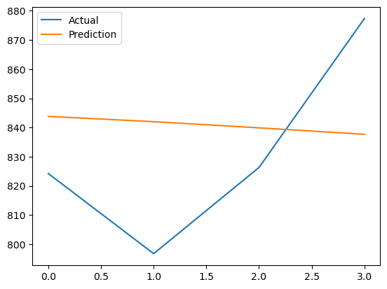
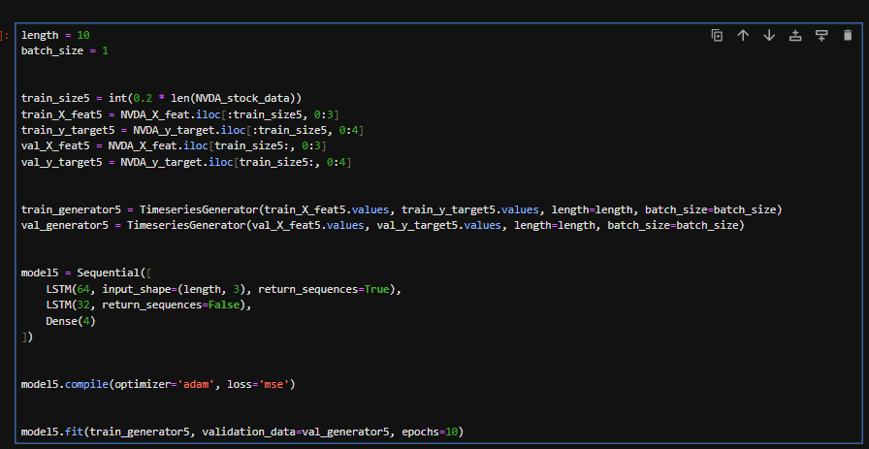
Predicting Features and Target

Slide 11
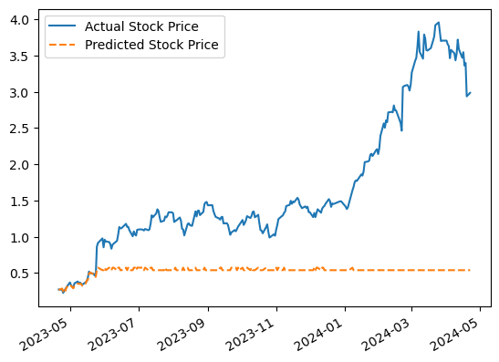
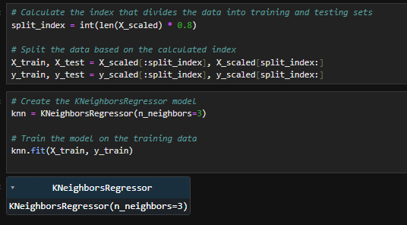
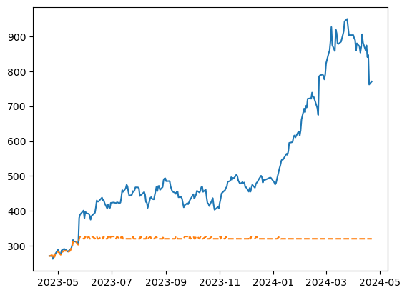
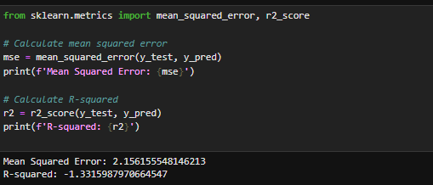

Slide 12
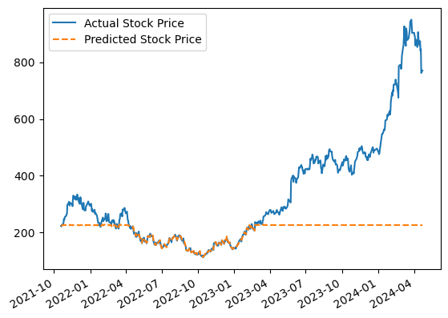
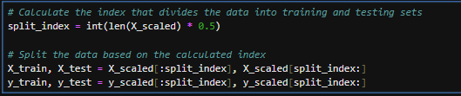
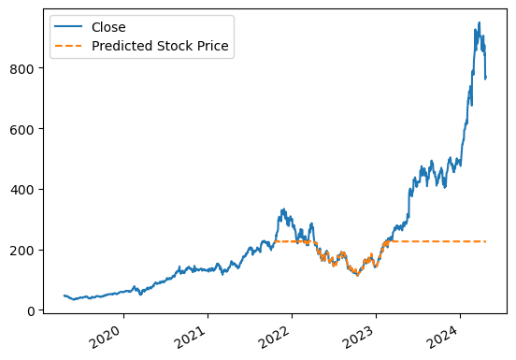

Slide 13
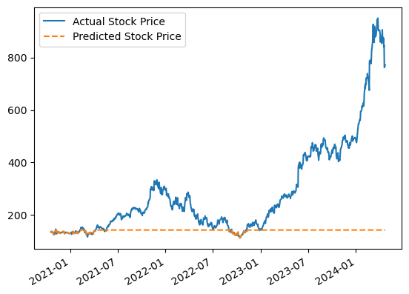
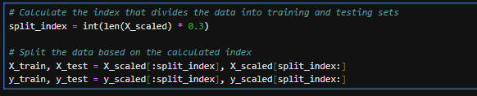
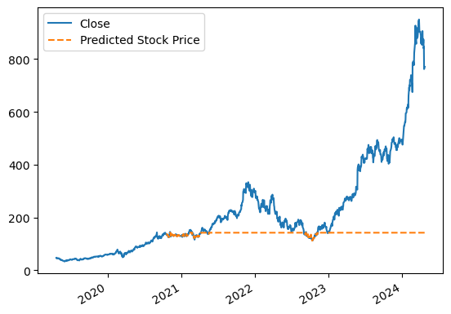

Slide 14
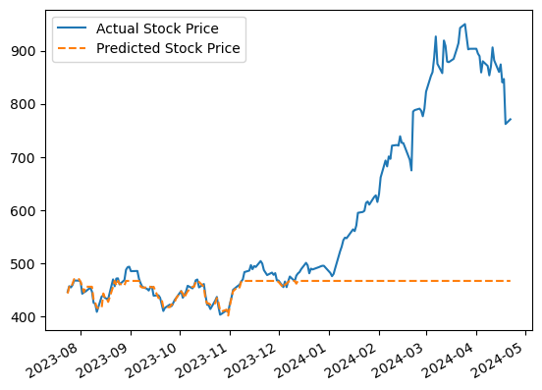
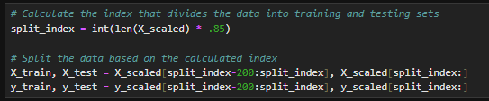
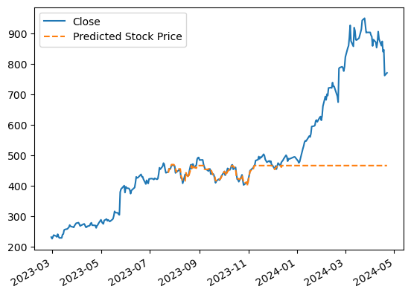

Slide 15
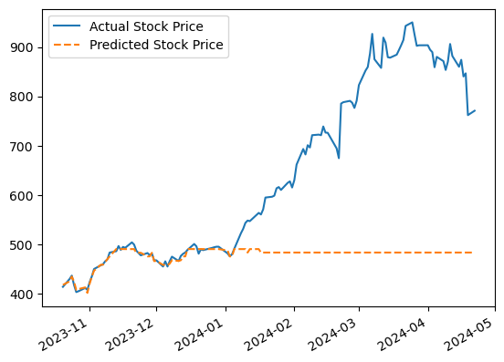
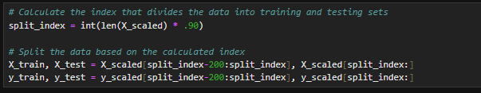

Slide 16
